Slide 1
Towards the Global Governance of Artificial General Intelligence AGI
Jerome C. Glenn, CEO
The Millennium Project

Slide 2

Three Forms of Artificial Intelligence
Artificial Narrow Intelligence
We are here now
Artificial General Intelligence
Artificial Super Intelligence

Slide 3

UN Security Council sessions on AI
2023, 2024, 2025

Slide 4
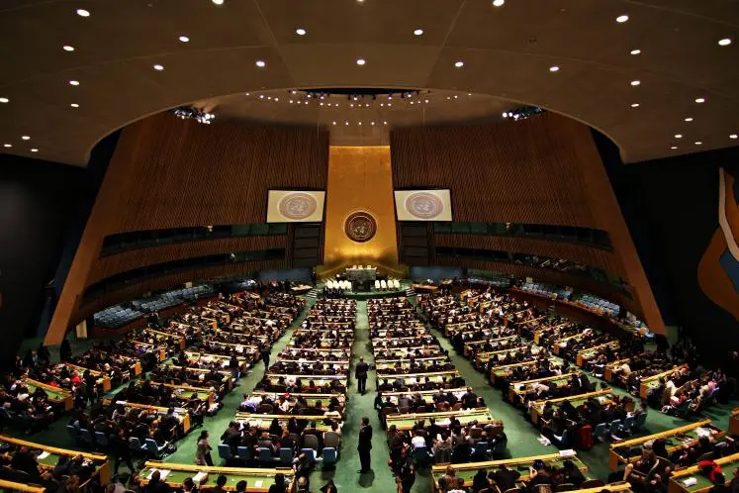
UN GA Adopted Two Resolutions on AI
US Initiated resolution: “Seizing the opportunities of safe, secure, and trustworthy artificial intelligence systems for sustainable development”
(A/78/L.49)
China initiated resolution “Enhancing international cooperation on capacity-building of artificial intelligence” (A/78/L.86)
Next, we need to address management of Artificial General Intelligence (AGI)

Slide 5

Parliaments agree on safe AGI cooperation
70 Parliamentary delegations and the Inter-Parliamentary Union agree to cooperate on developing AGI regulations.
September 2023

Slide 6
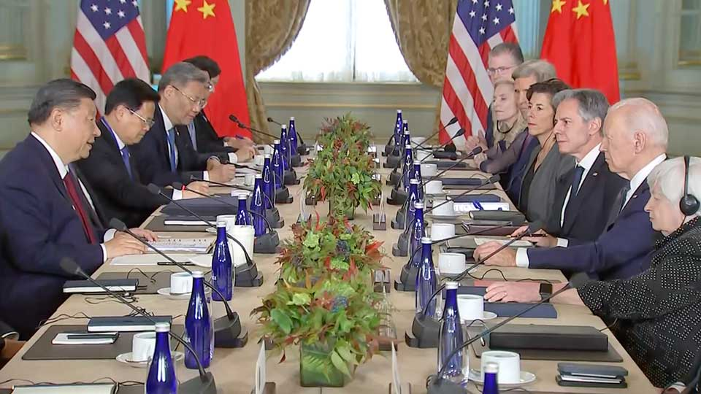
US-China Agree on Safe AI Cooperation
Public November 2023
Secrete meetings June and October 2023
(possibly on-going)

Slide 7

The OECD announced June 3t, 2025 that it is going to create indicators to measure progress towards AGI.
Introducing the OECD AI Capability Indicators https://doi.org/10.1787/be745f04-en

Slide 8

The State of the Future 20.0 is a whopping 555-page (print) 525- PDF) overview of the current situation and prospects for the future of the world
https://millennium-project.org/publications/state-of-the-future-version-20-0/

Slide 9
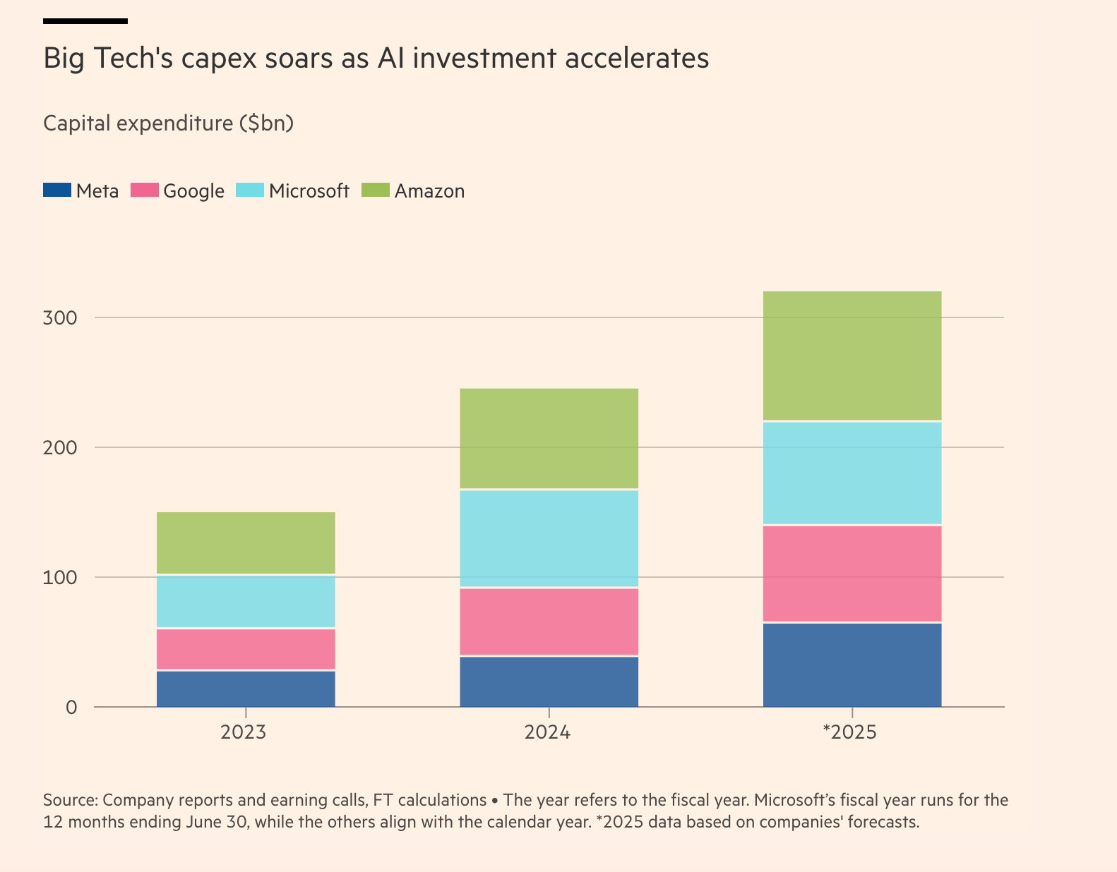

Slide 10

Governance of the Transition to
Artificial General Intelligence (AGI)
Urgent Considerations for the UN General Assembly https://uncpga.world/wp-content/uploads/2025/06/AGI-UNCPGA-Report-SPANISH.pdf

Slide 11
UN General Assembly on AGI should discuss
Global AGI Observatory—is needed to track progress in AGI-relevant research and development, and provide early warnings on AI security to Member States.
International System of Best Practices and Certification of Secure and Trustworthy AGI—is needed to identify best practices and provide certification for AGI security, development, and usage. Verification of AGI alignment with human values, controlled and non-deceptive behavior, and secure development is essential for international trust.
UN Framework Convention on AGI—is needed to establish shared objectives and flexible protocols to manage AGI risks and ensure equitable global benefit distribution.
Feasibility Study on a UN AGI Agency—understanding that managing AGI is far more complex than managing nuclear systems as with IAEA.

Slide 12
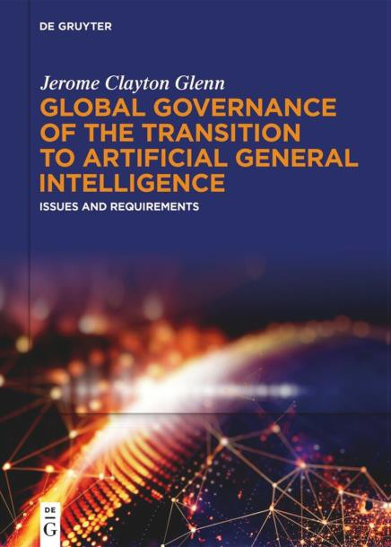
https://doi.org/10.1515/9783111674995
Executive Summary
22 Questions to 55 AGI Experts
40 regulations assessed
5 Governance Models assessed
Anwers compared with AI
Unresolved Issues

Slide 13

What Do We Need now?
UN General Assembly specifically on AGI leading to an International AGI Agency
National AGI licensing systems
    We should get all this done in three years.
    “This may be impossible…
    but we have to try”
    – Geoffrey Hinton
    It is the only moral position

